Slide 1

Flexible Group Fairness Metrics for Survival Analysis Part of Applied Data Science for Healthcare (DSHealth): Transparent and Human-centered AI at KDD 2022, Washington DC
Raphael Sonabend, Technische Universität Kaiserslautern, University of Cambridge, and Imperial College London Florian Pfisterer, Ludwig-Maximilians-Universität München Alan Mishler, J.P. Morgan AI Research Moritz Schauer, Chalmers Technical University and University of Gothenburg Lukas Burk, Ludwig-Maximilians-Universität München and Leibniz Institute for Prevention Research and Epidemiology - BIPS GmbH Sumantrak Mukherjee, Birla Institute of Technology and Science Sebastian Vollmer, Deutsches Forschungszentrum für Künstliche Intelligenz (DFKI), Technische Universität Kaiserslautern, and University of Warwick
Abstract Algorithmic fairness is an increasingly important field concerned with detecting and mitigating biases in machine learning models. There has been a wealth of literature for algorithmic fairness in regression and classification however there has been little exploration of the field for survival analysis. Survival analysis is the prediction task in which one attempts to predict the probability of an event occurring over time. Survival predictions are particularly important in sensitive settings such as when utilising machine learning for diagnosis and prognosis of patients. In this paper we explore how to utilise existing survival metrics to measure bias with group fairness metrics. We explore this in an empirical experiment with 29 survival datasets and 8 measures. We find that measures of discrimination are able to capture bias well whereas there is less clarity with measures of calibration and scoring rules. We suggest further areas for research including prediction-based fairness metrics for distribution predictions.
Paper, poster, recording, slides, code: https://github.com/Vollmer-Lab/survival_fairness
Notes:
Thank you for watching this recording.
I will be presenting our paper on fairness metrics for measuring group fairness in survival analysis
This recording, our poster, our paper, and all relevant code, can be found on the GitHub page linked on this slide.
In this paper we empirically assess existing measures in survival analysis to understand which can be used to evaluate group fairness
Define measures
We restrict our experiment to model-agnostic metrics that can be used to evaluate the fairness of any model, from simple non-parametric estimators, to machine learning methods

Slide 2
Survival fairness metrics
Fairness
Survival
Models can lead to, or exacerbate, disparities in health outcomes for marginalized populations.
Generally, fairness measures are utilized to understand if a model or dataset is biased towards one group or another.
Many definition of fairness exist including individual, group, intersectional, and causal.
Survival analysis is used in clinical prediction making to predict patient prognosis and decide treatment courses.
Literature is sparse for fairness metrics for survival analysis and currently no metrics exist that can be applied to any survival model to evaluate bias in any prediction type.

Slide 3
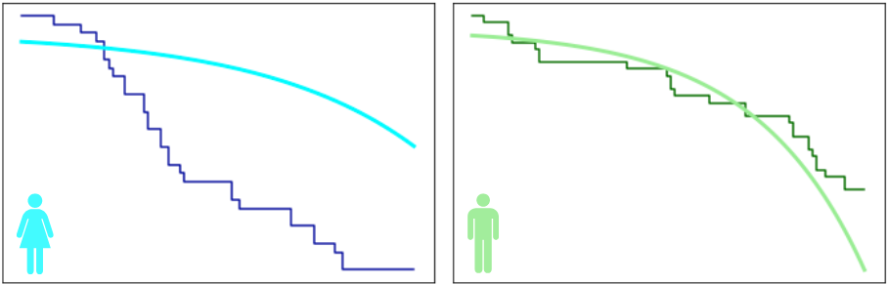
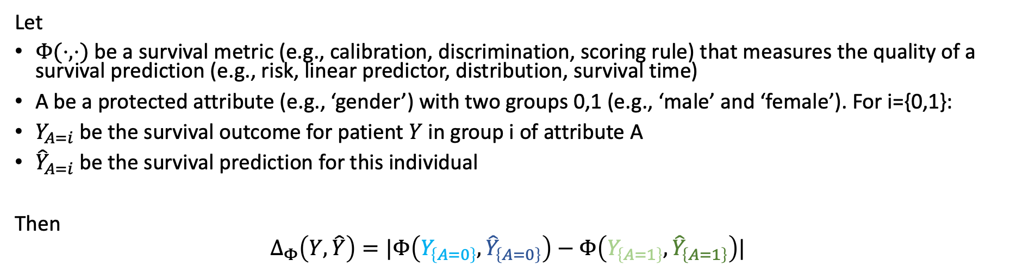
Model-agnostic fairness metrics
Let
$Φ(⋅,⋅)$ be a survival metric (e.g., calibration, discrimination, scoring rule) that measures the quality of a survival prediction (e.g., risk, linear predictor, distribution, survival time)
A be a protected attribute (e.g., ‘gender’) with two groups 0,1 (e.g., ‘male’ and ‘female’). For i={0,1}:
$Y_{A=i}$ be the survival outcome for patient $Y$ in group i of attribute A
${\hat{Y}}_{A=i}$ be the survival prediction for this individual
Then
$$Δ_{Φ}\left(Y, \hat{Y}\right)=|Φ\left(Y_{\left\{A=0\right\}}, {\hat{Y}}_{\left\{A=0\right\}}\right)−Φ\left(Y_{\left\{A=1\right\}}, {\hat{Y}}_{\left\{A=1\right\}}\right)|$$
Notes:
We define a class of survival fairness metrics that depend only on the chosen survival measure and are agnostic to model choice
This definition allows complete flexibility in the choice of model and measure, as long as Phi is a survival metric, i.e., a measure of discrimination, calibration, or a scoring rule that evaluates a survival outcome (which may be death or censoring) and a prediction of risk, survival distribution, survival time, or a linear predictor.
In this example, we see our model is biased as predictions are clearly inferior in the female group.

Slide 4
Experimental set-up
Measurement error (permutation)
Representation bias (undersampling)
Result of bias: Data for disadvantaged group is noisy; predictions will not capture true relationship between variables.
Result of bias: Data is heavily imbalanced against the disadvantaged group; predictions will be too heavily influenced by advantaged group.
Notes:
Experiment: we split a dataset into advantaged and disadvantaged groups, apply biasing method, train and test machine learning models with cross-validation and then compute the fairness metric for a range of survival measures.
Measurement bias: When data for disadvantaged groups of people is noisy and therefore models can less effectively learn the relationship between covariates and outcomes. We mimic this by randomly permute covariates in the disadvantaged group
Representation bias: When disadvantaged groups of people are underrepresented in data and therefore models are biased towards detecting patterns in the advantaged groups. We mimic this by undersampling the disadvantaged group which results in the predictions being heavily influenced by the advantaged group.
In both cases, we run the experiment multiple times with different degrees of bias. This allows us to better test if the chosen fairness metrics captures the bias as we would expect the absolute different in performance between groups to increase as the amount of bias increases.

Slide 5

Results
Let $ΔΦ=α+σβ$ be our regression model. Table shows intercept, ⍺, slope, β, and Spearman rank correlation, ⍴, for each ɸ and permutation (left) and undersampling (right) biasing methods. ’*’ indicates $p≤0.05$ after Holm's correction.
 | Permutation |  |  | Undersampling
ɸ | ⍺ | β | ⍴ | ⍺ | β | ⍴
RSBS | 0.049 | 0.078* | 0.976* | 0.035 | 0.066* | 0.855*
RISL | 0.045 | 0.063* | 0.976* | 0.033 | 0.058* | 0.891*
SNL | 0.018 | 0.001 | 0.248 | 0.014 | 0.083* | 1.000*
RCLL | 0.018 | 0.009 | 0.879* | 0.022 | 0.088* | 1.000*
C_{H} | 0.024 | 0.129* | 1.000* | 0.017 | 0.083* | 1.000*
C_{U} | 0.031 | 0.124* | 1.000* | 0.024 | 0.078* | 0.976*
CalA | 0.027 | 0.011* | 0.891* | -0.015 | 0.197* | 0.952*
CalD | 2.686 | 0.487 | 0.721* | 2.861 | 0.646 | 0.612
Notes:
This table shows the results of our empirical experiments across 29 datasets and both biasing methods
We tested 8 measures: re-weighted survival brier score, re-weighted integrated survival logloss, survival negative loglikelihood, right-censored logloss, Harrell’s C, uno’s C, van Houweligen’s Alpha and D-Calibration.
Briefly explain difference between measures of concordance, discrimination, scoring rules. Note we only include strictly proper scoring rules which capture both calibration and discrimination are used to test if one model performs significantly better than another
We tested scoring rules in an unstandardized and standardized form by standardizing w.r.t. Kaplan-Meier baseline. We found unstandardized scoring rules could not capture the bias, in addition they are uninterpretable as, for example, a logloss of 5.2 is not informative on its own. However, a standardized logloss of 0.2 has a clear interpretation: 20% better performance than a Kaplan-Meier model.
The measures in bold (read them out) are significant for both the regression model and the Spearman rank correlation, for both biasing methods
We used Holm’s correction to correct for multiple testing biases

Slide 6
Conclusions and future research
We demonstrated how existing survival measures can be utilised to audit bias in algorithmic fairness.
We found existing discrimination, calibration, and scoring rule measures for capturing model-agnostic bias but these depend on bias type and still require expert knowledge.
Future research:
Understanding individual, intersectional, and counterfactual error-based fairness;
Metrics for model-agnostic prediction-based fairness;
Making survival fairness more accessible;
Understanding how decision makers think about and utilise fairness.

